Slide 1

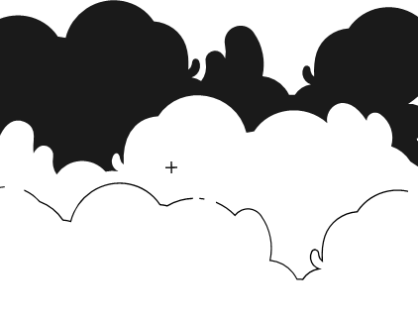
PRINCIPLES OF ARTIFICIAL INTELLIGENCE
SOF106
DR SHAMINI RAJA KUMARAN
GRAPH SEARCH STRATEGIES
-ADVERSARIAL SEARCH-
www.website.com
PREPARED BY DR SHAMINI

Slide 2
XMUM VISION
Xiamen University Malaysia aspires to become a university with a distinct global outlook, featuring first-class teaching and research, and embracing cultural diversity.
XMUM MISSION
To nurture young talents with dignity and wisdom, turning them into fine citizens of the region who will contribute to the prosperity of the people and social progress of Malaysia, China and Southeast Asia.To nurture young talents with dignity and wisdom, turning them into fine citizens of the region who will contribute to the prosperity of the people and social progress of Malaysia, China and Southeast Asia.

Slide 3
PROBLEM SEARCH SOLVING TECHNOLOGY
SEARCH STRATEGIES
1. UNINFORMED SEARCHING
2. INFORMED SEARCHING + LOCAL SEARCH
3. ADVANCED SEARCHING (HILL CLIMBING+SIMULATED ANNEALING)
4. ADVERSARIAL SEARCHING

Slide 4
GAMES VS SEARCH PROBLEMS
"Unpredictable" opponent → solution is a strategy specifying a move for every possible opponent reply
Time limits → unlikely to find goal, must approximate
History:
  Computer considers possible lines of play (Babbage, 1846)
  Algorithm for perfect play (Zermelo, 1912; Von Neumann, 1944)
  Finite horizon, approximate evaluation (Zuse, 1945; Wiener, 1948; Shannon, 1950)
  First Chess Program (Turing, 1951)
  Machine learning to improve evaluation accuracy (Samuel, 1952-57)
  Pruning to allow deeper search (McCarthy, 1956)
Games like Chess or Go are compact settings that mimic the uncertainty of interacting with the natural world
For centuries humans have used them to exert their intelligence
Recently, there has been great success in building game programs that challenge human supremacy

Slide 5
TYPE OF GAMES

Slide 6
GAMES TOWARD ADVERSARIAL SEARCH
  Example: Tic-Tac-Toe game tree:
  The following figure is showing part of the game-tree for tic-tac-toe game. Following are some key points of the game:
There are two players MAX and MIN.
Players have an alternate turn and start with MAX.
MAX maximizes the result of the game tree MAX玩家尽可能让自己的分数最大化
MIN minimizes the result. MIN玩家试图最小化MAX能得到的分数

Slide 7
GAMES TOWARD ADVERSARIAL SEARCH

Slide 8
GAMES TOWARD ADVERSARIAL SEARCH
EXAMPLE OF EXPLANATION
From the initial state, MAX has 9 possible moves as he starts first. MAX place x and MIN place o, and both player plays alternatively until we reach a leaf node where one player has three in a row or all squares are filled.
Both players will compute each node, minimax, the minimax value which is the best achievable utility against an optimal adversary.
Suppose both the players are well aware of the tic-tac-toe and playing the best play. Each player is doing his best to prevent another one from winning. MIN is acting against Max in the game.
So in the game tree, we have a layer of Max, a layer of MIN, and each layer is called as Ply. Max place x, then MIN puts o to prevent Max from winning, and this game continues until the terminal node.
In this either MIN wins, MAX wins, or it's a draw. This game-tree is the whole search space of possibilities that MIN and MAX are playing tic-tac-toe and taking turns alternately.

Slide 9
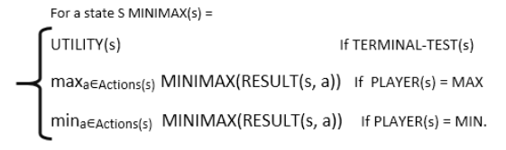
GAMES TOWARD ADVERSARIAL SEARCH
EXAMPLE OF EXPLANATION
Hence adversarial Search for the minimax procedure works as follows:
It aims to find the optimal strategy for MAX to win the game.
It follows the approach of Depth-first search.
In the game tree, optimal leaf node could appear at any depth of the tree.不论是早期的决策（靠近根节点）还是晚期的决策（靠近叶子节点），都可能存在一个最优的结果
Propagate the minimax values up to the tree until the terminal node discovered.
In a given game tree, the optimal strategy can be determined from the minimax value of each node, which can be written as MINIMAX(n). MAX prefer to move to a state of maximum value and MIN prefer to move to a state of minimum value then:

Slide 10
GAMES TOWARD ADVERSARIAL SEARCH
PROBLEM FORMULATION
State space
Initial state
Successor function: it tells which actions can be executed in each state and gives the successor state for each action
MAX’s and MIN’s actions alternate, with MAX playing first in the initial state
Terminal test: it tells if a state is terminal and, if yes, if it’s a win or a loss for MAX, or a draw
All states are fully observable

Slide 11
MIN-MAX SEARCH
Min-max algorithm is a recursive or backtracking algorithm which is used in decision-making and game theory. It provides an optimal move for the player assuming that opponent is also playing optimally.
MAX 会选择那些能让他获得最高 minimax 值的节点（行动）
Min-Max algorithm uses recursion to search through the game-tree.
Min-Max algorithm is mostly used for game playing in AI. Such as Chess, Checkers, tic-tac-toe, go, and various two-players game. This Algorithm computes the minimax decision for the current state.
In this algorithm two players play the game, one is called MAX and other is called MIN.
Both the players fight it as the opponent player gets the minimum benefit while they get the maximum benefit.

Slide 12
MIN-MAX SEARCH
（Both Players of the game are opponent of each other, where MAX will select the maximized value and MIN will select the minimized value.）
The minimax algorithm performs a depth-first search algorithm for the exploration of the complete game tree.
The minimax algorithm proceeds all the way down to the terminal node of the tree, then backtrack the tree as the recursion.

Slide 13
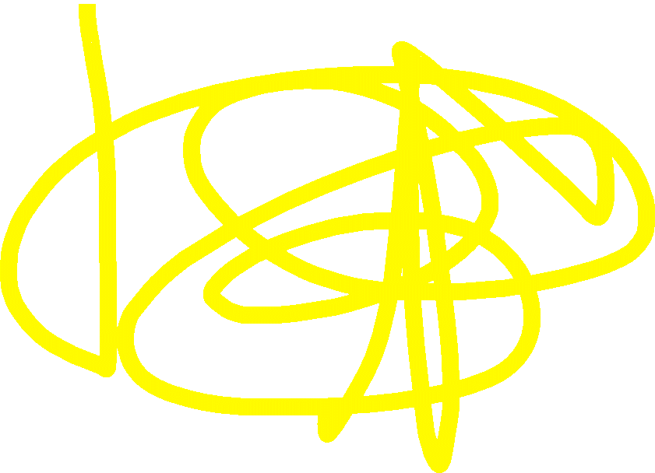
MIN-MAX SEARCH
function minimax(node, depth, maximizingPlayer) is
if depth ==0 or node is a terminal node then
return static evaluation of node
if MaximizingPlayer then // for Maximizer Player
maxEva= -infinity
for each child of node do
eva= minimax(child, depth-1, false)
maxEva= max(maxEva,eva) //gives Maximum of the values
return maxEva
else // for Minimizer player
minEva= +infinity
for each child of node do
eva= minimax(child, depth-1, true)
minEva= min(minEva, eva) //gives minimum of the values
return minEva

Slide 14
MIN-MAX SEARCH
The working of the minimax algorithm can be easily described using an example. Below we have taken an example of game-tree which is representing the two-player game.
In this example, there are two players one is called Maximizer and other is called Minimizer.
Maximizer will try to get the Maximum possible score, and Minimizer will try to get the minimum possible score.
This algorithm applies DFS, so in this game-tree, we have to go all the way through the leaves to reach the terminal nodes.
At the terminal node, the terminal values are given so we will compare those value and backtrack the tree until the initial state occurs. Following are the main steps involved in solving the two-player game tree:

Slide 15
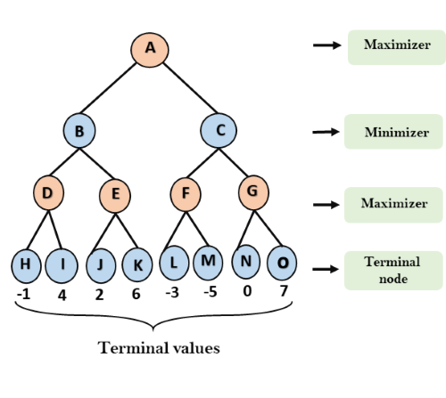
MIN-MAX SEARCH
Step-1: In the first step, the algorithm generates the entire game-tree and apply the utility function to get the utility values for the terminal states. In the below tree diagram, let‘s take A is the initial state of the tree. Suppose maximizer takes first turn which has worst-case initial value =- infinity（任何合法的值都比这个初始值好）, and minimizer will take next turn which has worst-case initial value = +infinity.

Slide 16
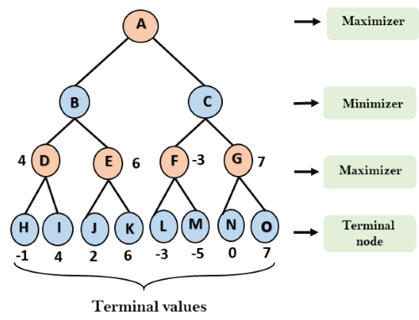
MIN-MAX SEARCH
Step 2: Now, first we find the utilities value for the Maximizer, its initial value is -∞, so we will compare each value in terminal state with initial value of Maximizer and determines the higher nodes values. It will find the maximum among the all.
For node D max(-1,- -∞) => max(-1,4)= 4
For Node E max(2, -∞) => max(2, 6)= 6
For Node F max(-3, -∞) => max(-3,-5) = -3
For node G max(0, -∞) = max(0, 7) = 7

Slide 17
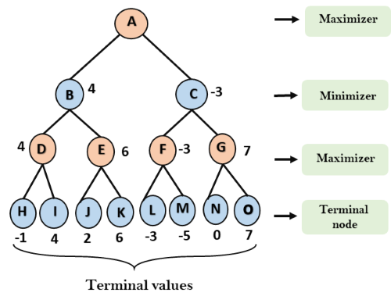
MIN-MAX SEARCH
Step 3: In the next step, it's a turn for minimizer, so it will compare all nodes value with +∞, and will find the 3rd layer node values.
For node B= min(4,6) = 4
For node C= min (-3, 7) = -3

Slide 18
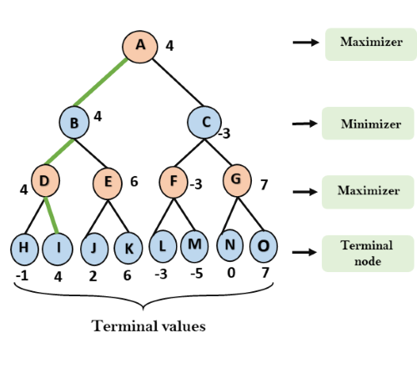
MIN-MAX SEARCH
Step 4: Now it's a turn for Maximizer, and it will again choose the maximum of all nodes value and find the maximum value for the root node. In this game tree, there are only 4 layers, hence we reach immediately to the root node, but in real games, there will be more than 4 layers.
For node A max(4, -3)= 4

Slide 19
MIN-MAX SEARCH - PROPERTIES
Complete- Min-Max algorithm is Complete. It will definitely find a solution (if exist), in the finite search tree.
Optimal- Min-Max algorithm is optimal if both opponents are playing optimally.
Time complexity- As it performs DFS for the game-tree, so the time complexity of Min-Max algorithm is O(b^{m}), where b is branching factor of the game-tree, and m is the maximum depth of the tree.
Space Complexity- Space complexity of Mini-max algorithm is also similar to DFS which is O(bm).
Limitation of the minimax Algorithm:
The main drawback of the minimax algorithm is that it gets really slow for complex games such as Chess, go, etc. This type of games has a huge branching factor, and the player has lots of choices to decide. This limitation of the minimax algorithm can be improved from alpha-beta pruning.

Slide 20
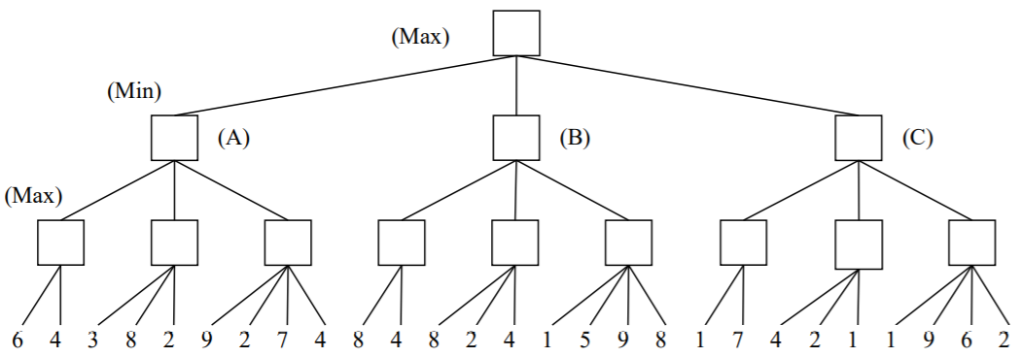



MIN-MAX SEARCH
EXERCISE

Slide 21
ALPHA-BETA PRUNING
Alpha-beta pruning is a modified version of the minimax algorithm. It is an optimization technique for the minimax algorithm.
As we have seen in the minimax search algorithm that the number of game states it has to examine are exponential in depth of the tree. Since we cannot eliminate the exponent, but we can cut it to half. Hence there is a technique by which without checking each node of the game tree we can compute the correct minimax decision, and this technique is called pruning.
This involves two threshold parameter Alpha and beta for future expansion, so it is called alpha-beta pruning.

Slide 22
ALPHA-BETA PRUNING
Alpha-beta pruning can be applied at any depth of a tree, and sometimes it not only prune the tree leaves but also entire sub-tree.
The two-parameter can be defined as:
  Alpha: The best (highest-value) choice we have found so far at any point along the path of Maximizer. The initial value of alpha is -∞.对于各自来说都是optimal的决定
  Beta: The best (lowest-value) choice we have found so far at any point along the path of Minimizer. The initial value of beta is +∞.
The Alpha-beta pruning to a standard minimax algorithm returns the same move as the standard algorithm does, but it removes all the nodes which are not really affecting the final decision but making algorithm slow. Hence by pruning these nodes, it makes the algorithm fast.

Slide 23
ALPHA-BETA PRUNING
The main condition which required for alpha-beta pruning is: α>=β
Max player will only update the value of alpha.
Min player will only update the value of beta.
While backtracking the tree, the node values will be passed to upper nodes instead of values of alpha and beta.
We will only pass the alpha, beta values to the child nodes.

Slide 24
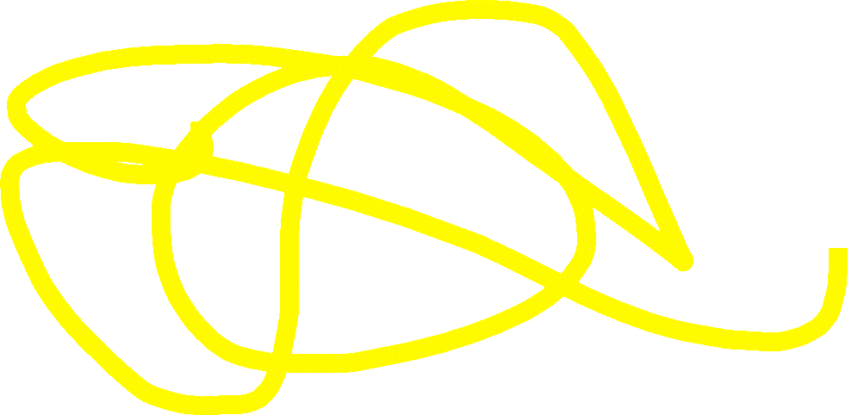
ALPHA-BETA PRUNING
function minimax(node, depth, alpha, beta, maximizingPlayer) is
if depth ==0 or node is a terminal node then
return static evaluation of node
if MaximizingPlayer then // for Maximizer Player
maxEva= -infinity
for each child of node do
eva= minimax(child, depth-1, alpha, beta, False)
maxEva= max(maxEva, eva)
alpha= max(alpha, maxEva)
if beta<=alpha
break
return maxEva
else // for Minimizer player
minEva= +infinity
for each child of node do
eva= minimax(child, depth-1, alpha, beta, true)
minEva= min(minEva, eva)
beta= min(beta, eva)
if beta<=alpha
break
return minEva

Slide 25
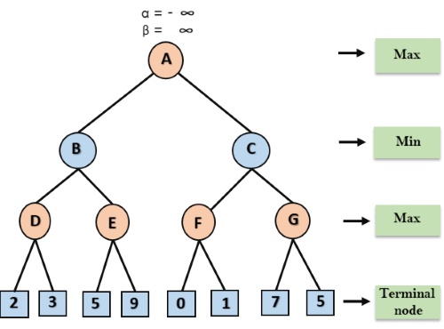
ALPHA-BETA PRUNING
An example of two-player search tree to understand the working of Alpha-beta pruning.
Step 1: At the first step the, Max player will start first move from node A where α= -∞ and β= +∞, these value of alpha and beta passed down to node B where again α= -∞ and β= +∞, and Node B passes the same value to its child D.
Bring down first
Only the first branch be compared every node

Slide 26
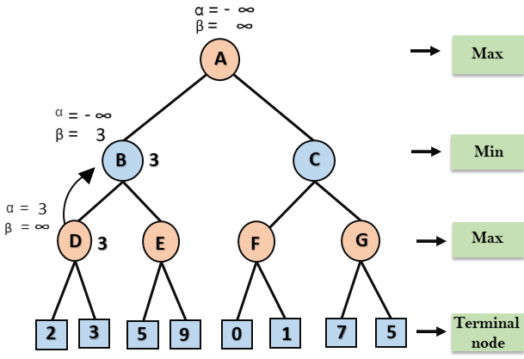
ALPHA-BETA PRUNING
Step 2: At Node D, the value of α will be calculated as its turn for Max. The value of α is compared with firstly 2 and then 3, and the max (2, 3) = 3 will be the value of α at node D and node value will also 3.
Step 3: Now algorithm backtrack to node B, where the value of β will change as this is a turn of Min, Now β= +∞, will compare with the available subsequent nodes value, i.e. min (∞, 3) = 3, hence at node B now α= -∞, and β= 3.
In the next step, algorithm traverse the next successor of Node B which is node E, and the values of α= -∞, and β= 3 will also be passed.

Slide 27
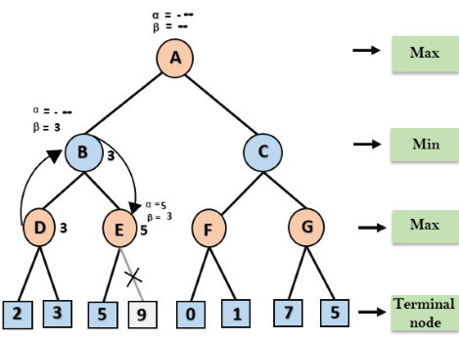
ALPHA-BETA PRUNING
Step 4: At node E, Max will take its turn, and the value of alpha will change. The current value of alpha will be compared with 5, so max (-∞, 5) = 5, hence at node E α= 5 and β= 3, where α>=β, so the right successor of E will be pruned, and algorithm will not traverse it, and the value at node E will be 5.
Follow the DFS sequence

Slide 28
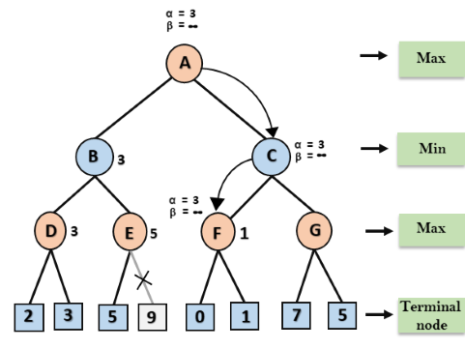
ALPHA-BETA PRUNING
Step 5: At next step, algorithm again backtrack the tree, from node B to node A. At node A, the value of alpha will be changed the maximum available value is 3 as max (-∞, 3)= 3, and β= +∞, these two values now passes to right successor of A which is Node C. At node C, α=3 and β= +∞, and the same values will be passed on to node F.
Step 6: At node F, again the value of α will be compared with left child which is 0, and max(3,0)= 3, and then compared with right child which is 1, and max(3,1)= 3 still α remains 3, but the node value of F will become 1.

Slide 29
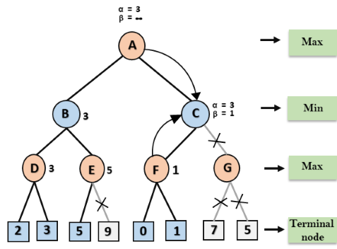
ALPHA-BETA PRUNING
Step 7: Node F returns the node value 1 to node C, at C α= 3 and β= +∞, here the value of beta will be changed, it will compare with 1 so min (∞, 1) = 1. Now at C, α=3 and β= 1, and again it satisfies the condition α>=β, so the next child of C which is G will be pruned, and the algorithm will not compute the entire sub-tree G.
C点只取小值更新到β，最大值α不更新---而下一个回溯点A取现阶段的α，所以G再怎么更新大值也无意义。

Slide 30
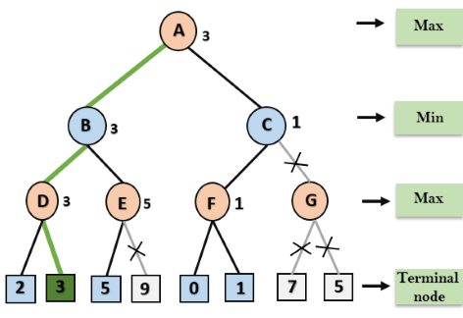
ALPHA-BETA PRUNING
Step 8: C now returns the value of 1 to A here the best value for A is max (3, 1) = 3. Following is the final game tree which is the showing the nodes which are computed and nodes which has never computed. Hence the optimal value for the maximizer is 3 for this example.

Slide 31
ALPHA-BETA PRUNING-PROPERTIES
The effectiveness of alpha-beta pruning is highly dependent on the order in which each node is examined. Move order is an important aspect of alpha-beta pruning.
It can be of two types:
Worst ordering: In some cases, alpha-beta pruning algorithm does not prune any of the leaves of the tree, and works exactly as minimax algorithm. In this case, it also consumes more time because of alpha-beta factors, such a move of pruning is called worst ordering. In this case, the best move occurs on the right side of the tree. The time complexity for such an order is O(b^{m}).
Ideal ordering: The ideal ordering for alpha-beta pruning occurs when lots of pruning happens in the tree, and best moves occur at the left side of the tree. We apply DFS hence it first search left of the tree and go deep twice as minimax algorithm in the same amount of time？？？. Complexity in ideal ordering is O(b^{m/2}).

Slide 32
ALPHA-BETA PRUNING :
FIND GOOD ORDERING
Following are some rules to find good ordering in alpha-beta pruning:
Occur the best move from the shallowest node.如果在树的浅层就找到了一个非常好的值（例如，对于 MAX 来说是一个很大的值），后续较深层的节点就很容易被剪掉
Order the nodes in the tree such that the best nodes are checked first.
Use domain knowledge while finding the best move. Ex: for Chess, try order: captures first, then threats, then forward moves, backward moves.

Slide 33
COMPLETED PART 3
ADVERSARIAL SEARCHING

Slide 34
THANK YOU
www.website.com
PREPARED BY DR SHAMINI

